Slide 1
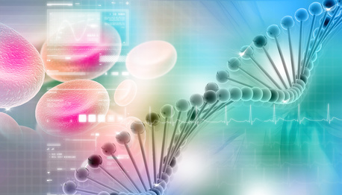
Genetics & Inheritance
Chapters 13 & 14

Slide 2
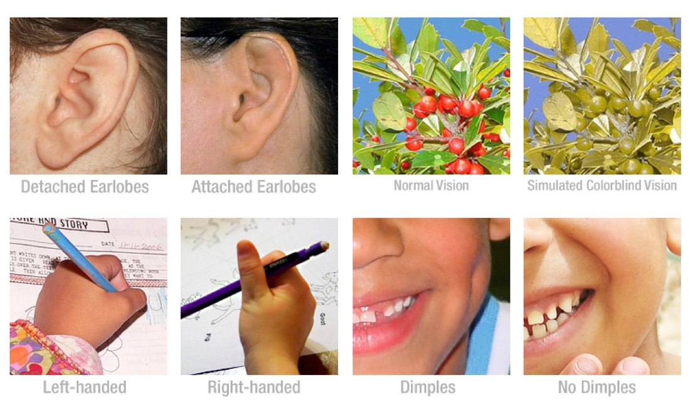
What is genetics?
Genetics is the study of heredity, the process in which a parent passes certain genes onto their children.
What does this mean?
Children inherit their biological parents’ genes that express specific traits, such as some physical characteristics, natural talents, and genetic disorders.

Slide 3
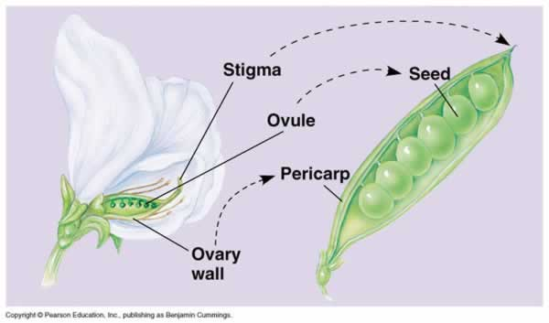
Gregor Mendel
Gregor Mendel, and Austrian monk, worked out the basic rules of inheritance. Although many more principles have been discovered since Mendel’s work, our modern understanding of genetics can be traced back to Mendel.
Mendel’s goal was to discover how traits that are present in parents behave in subsequent generations. He thought that sperm and eggs carried specific units of inheritance.
To do this Mendel used varieties of the garden pea (Pisum sativum) that differed in some distinct way. They had different states of the same character: pea shape: round vs. wrinkled, pod color: yellow vs. green, flower color: white vs. purple. He carefully crossed contrasting varieties and kept a record of the number and characteristics of the offspring they produced.
Why use pea plants?
Self-fertilizing: flowers produce both
male and female gametes
Cross-fertilizing: transfer pollen from
one plant to another plant
Notes:
Mendel worked on inheritance in the garden pea, in the 1850s and 1860s. His work was published but was largely unnoticed until the early 1900s, when a number of other biologists began to work on the same problem and rediscovered many of the things Mendel had 40 years earlier. Mendel is given credit for having discovered the basic rules of inheritance first.
Mendel was able to work out the rules of inheritance because he used a methodical approach, kept careful records of his results, and had good mathematical abilities. His math background gave him insight into what was happening during the production of gametes and during syngamy, even though he had never viewed cells in meiosis or fertilization.

Slide 4
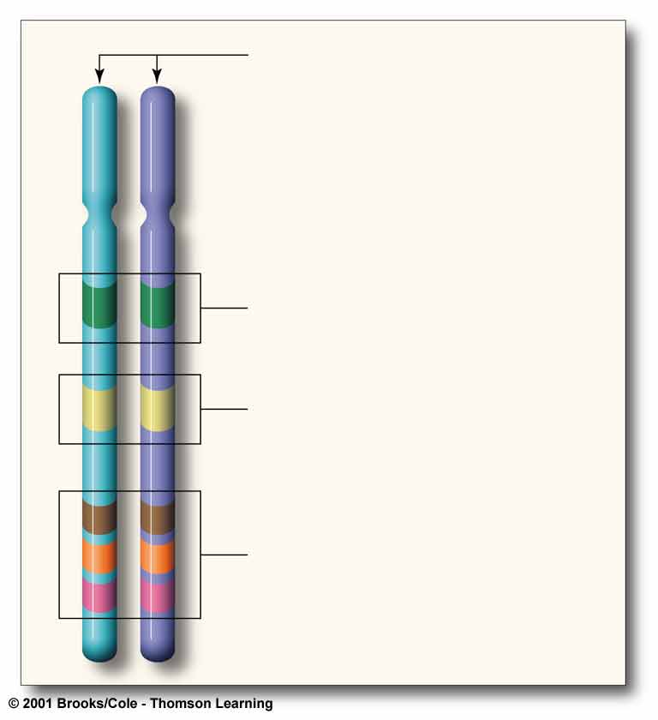
a A pair of homologous chromosomes,
each in the unduplicated state (most
often, one from a male parent and its
partner from a female parent).
Figure 11.4 on Page 171
A few genetic terms. Garden peas and other species with a diploid chromosome number have pairs of genes, on pairs of homologous chromosomes.
Most genes come in slightly difference molecular forms called alleles. Different alleles specify different versions of the same trait. An allele at any given location on a chromosome may or may not be identical to its partner on the homologous chromosome.
b A gene locus (plural, loci), the location
for a specific gene on a chromosome.
Alleles are at corresponding loci on a
pair of homologous chromosomes.
c A pair of alleles may be identical or
nonidentical. They are represented
in the text by letters such as D or d.
d Three pairs of genes (at three loci on this pair of homologous chromosomes); same thing as three pairs of alleles.

Slide 5
Genetic Terminology
Genes – are units of information on heritable traits. Each gene has a specific location (locus) in chromosomal DNA.
Allele – all the molecular forms of the same gene.
(represented by a factor or letter that makes up a gene)
Example: “B” represents brown eyes
Autosomal – refers to the genes that are not found on the sex chromosomes.
XX = ♀ XY = ♂
Trait – is a feature of an organism.
Example: brown eyes/ white fur/ smooth texture
Hybrid – inheritance of non-identical alleles for a trait.

Slide 6
Genetic Terminology Continued…
Carrier – a person who has a defective gene, but has a dominant normal gene and is therefore normal.
Example: Nn N=normal / n=sick
Dominant – an allele that overpowers another. (B)
Recessive – an allele that is smaller or weaker and are masked. (b)
Genotype – all the genes possessed by an organism.
(the possible alleles)
Phenotype – the way an organism looks/ physical descriptions
(observable traits)
Homozygous – a pair of identical alleles on a homologous chromosome. (BB or bb)
Heterozygous – a pair of non-identical alleles on a homologous chromosome. (Bb)

Slide 7
Back to Mendel…
Mendel began his crosses with two true-breeding varieties of plants with a different state of the same characteristic such as white and purple flower color. The parents are the P1 – the parental generation.
P₁: purple x white
F₁: purple
F₁ x F₁: purple x purple
F₂: ~3/4 purple & ~1/4 white
The offspring of the P1 are the F1
generation (first filial generation)
Mendel found one of the parental
states was expressed in the F1.
He then crossed the F1 among
themselves or allowed them to self-fertilize.
In the F2 (second filial) generation
Mendel found a ratio of
approximately 3 to 1.

Slide 8
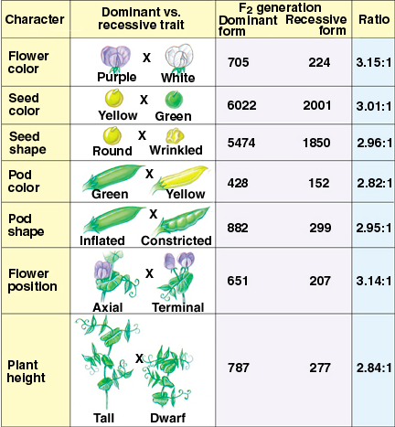
Mendel found the same pattern in all seven of the traits he studied.

Slide 9
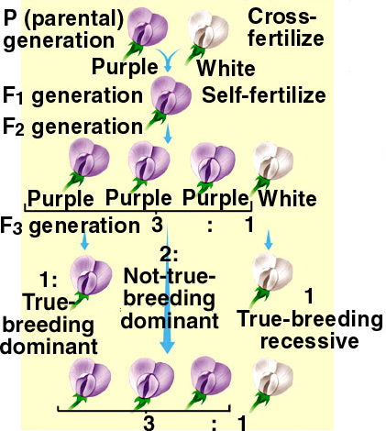
Mendel’s results raised two questions:
How can a trait be masked in F1 generation and reappear in the F2?
2. Why does the F2 generation consist of 3:1?

Slide 10
Mendel’s answers…
The factors (genes) that determine the characteristics of an organism occur in pairs, every individual possesses two factors and the factors come in alternative forms (alleles)
The members of a factor pair are separated during gamete formation; gametes
carry only one factor. This is Mendel’s Law of Segregation.
When alternative forms of a factor (alleles) are combined, one form masks the
expression of other members of a factor pair This is Mendel’s Law of Dominance.
4. During fertilization gametes combine randomly

Slide 11
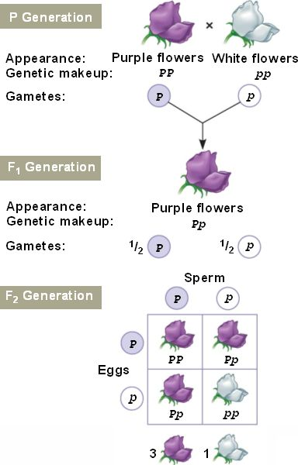
Mendel's Theory of Segregation **diploid cells have pairs of genes on pairs of homologous chromosomes. The two genes of each pair are separated during meiosis and end up in different gametes.
Mendel crossed true-breeding purple and white flowered plants.
This symbol represents a genetic cross or mating.
The F₁ offspring of PP x pp plants all have genotype Pp.
The plants of the F₁ generation were allowed to self-fertilize.
Each egg and each sperm produced by the F₁ plants has a 50% chance of receiving a P allele and a 50% chance of receiving a p allele.
Eggs and sperm combine randomly in four ways to form F₂ plants.
The Punnett square method predicts 3 purple flowered offspring for every 1 white flowered offspring, a 3:1 ratio.

Slide 12
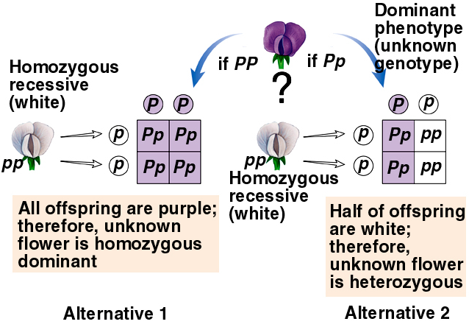
Mendel tested his explanation with more crosses. One cross that he used is a testcross: a cross of an individual with a dominant phenotype, but unknown genotype, to an individual with a recessive phenotype.
Used to determine whether an individual is homozygous dominant or heterozygous dominant

Slide 13
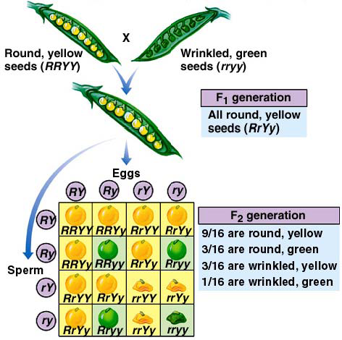
Mendel's Theory of Independent Assortment **As meiosis ends, genes on pairs of homologous chromosomes have been sorted out for distribution into one gamete or anther, independently of gene pairs on other chromosomes.
Mendel also looked at the inheritance of two traits simultaneously and found that in the F2 there was always an approximate 9:3:3:1 ratio.
His explanation:
During gamete formation members of one gene pair segregate independently of members of other gene pairs
This is Mendel’s Law of Independent Assortment.
Notes:
Mendel didn’t see evidence of genes that don’t assort independently, or if he did, he didn’t report it. Genes on the same chromosome can’t assort independently - they are called linked genes.
If crossing-over weren’t possible, heterozygotes for two linked genes could only produce two combinations of genes in their gametes, instead of four.
t t T T
X X
u u U U
tu tu TU TU

Slide 14
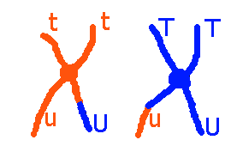

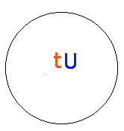
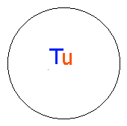

With crossing-over all four combinations of alleles of the two genes can be produced:
Two of the gametes have combinations that were not the product of crossing over (tu and TU) - these are called non-recombinant or parental type gametes.
Two of the gametes have new combinations of genes (Tu, and tU) - these are called recombinant gametes.

Slide 15
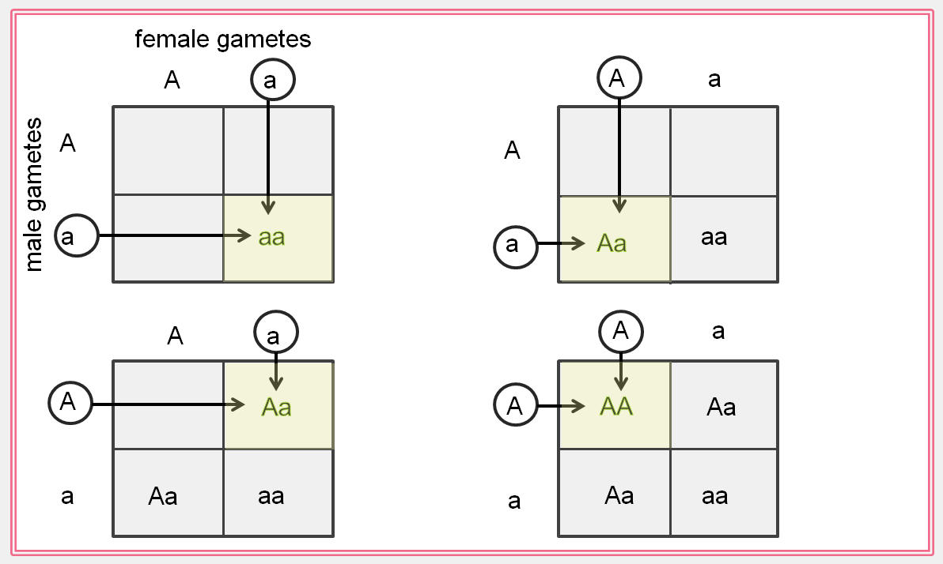
Punnett-Square Method
Shows all possible outcomes

Slide 16
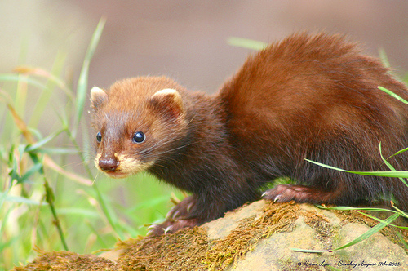
Practice Genetics Problems – Monohybrid Cross
In minks, coat color is controlled by a single gene. The allele for a brown (B) coat is dominant to the allele for silverblue (b) coats. A homozygous brown mink was crossed with a silverblue mink. There were 9 offspring in the F₁ generation. What color were they?
B = brown coats
b = silverblue coats
♀
♂

Slide 17

Monohybrid Practice Problems Continued…
In tomatoes, red fruit (R) is dominant over yellow fruit (r). A plant that is homozygous for red fruit is crossed with a plant that has yellow fruit. What would be the genotypes and phenotypes of the P1 and F1 generations?
R = red fruit
r = yellow fruit
♀
♂

Slide 18

Incomplete Dominance
** One allele of a pair is not fully dominant over its partner, so the heterozygote’s phenotype is somewhere between the two homozygotes.
If a homozygous red snapdragon is crossed with a heterozygous pink snapdragon, what are the genotypic and phenotypic ratios of the offspring?
RR = red flowers
Rr = pink flowers
rr = white flowers
♀
♂

Slide 19
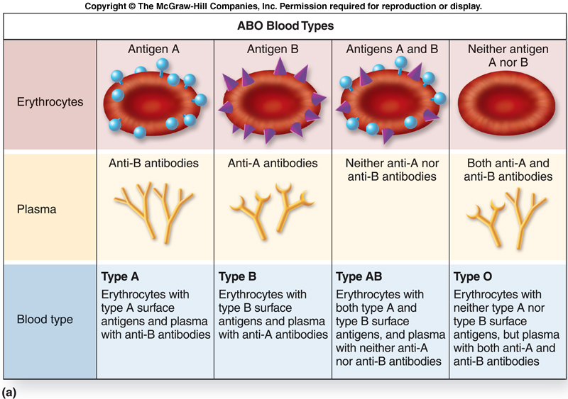
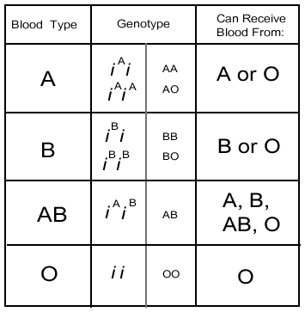
Codominance
** A pair of non-identical alleles affecting two phenotypes
are both expressed at the same time in heterozygotes.

Slide 20
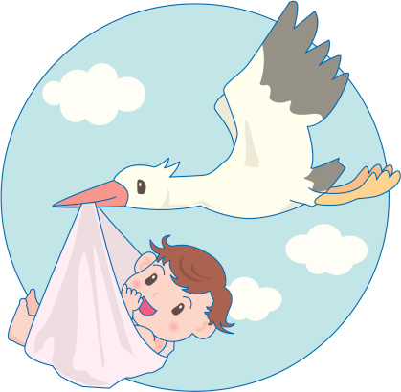
Emma grace and Christopher have been happily married for 5 years and are planning to begin building a family. Emma grace has O blood and Christopher is heterozygous for A blood. What are the possible genotypes and phenotypes of their potential offspring?
♀
♂

Slide 21
Rh Blood Typing
Rh blood types were discovered in 1940 by Karl Landsteiner and Alexander Wiener. This was 40 years after Landsteiner had discovered the ABO blood groups. Over the last half century, we have learned far more about the processes responsible for Rh types. This blood group may be the most complex genetically of all blood type systems since it involves 45 different antigens on the surface of red cells that are controlled by 2 closely linked genes on chromosome 1.
The Rh system was named after rhesus monkeys, since they were initially used in the research to make the antiserum for typing blood samples. If the antiserum agglutinates your red cells, you are Rh+. If it doesn't, you are Rh-. Despite its actual genetic complexity, the inheritance of this trait usually can be predicted by a simple conceptual model in which there are two alleles, D and d. Individuals who are homozygous dominant (DD) or heterozygous (Dd) are Rh+. Those who are homozygous recessive (dd) are Rh- (i.e., they do not have the key Rh antigens).
The greatest problem with the Rh group is not so much incompatibilities following transfusions (though they can occur) as those between a mother and her developing fetus. Mother-fetus incompatibility occurs when the mother is Rh- (dd) and her fetus is Rh+ (DD or Dd). Maternal antibodies can cross the placenta and destroy fetal red blood cells. The risk increases with each pregnancy.

Slide 22
Erythroblastosis fetalis
The first time an Rh- woman becomes pregnant, there usually are not incompatibility difficulties for her Rh+ fetus. However, the second and subsequent births are likely to have life-threatening problems for Rh+ fetuses. The risk increases with each birth.
Normally, anti-Rh+ antibodies do not exist in the first-time mother unless she has previously come in contact with Rh+ blood. Therefore, her antibodies are not likely to agglutinate the red blood cells of her Rh+ fetus. Placental ruptures do occur normally at birth so that some fetal blood gets into the mother's system, stimulating the development of antibodies to Rh+ blood antigens. As little as one drop of fetal blood stimulates the production of large amounts of antibodies. When the next pregnancy occurs, a transfer of antibodies from the mother's system once again takes place across the placental boundary into the fetus. The anti-Rh+ antibodies that she now produces react with the fetal blood, causing many of its red cells to burst or agglutinate. As a result, the newborn baby may have a life-threatening anemia because of a lack of oxygen in the blood. The baby also usually is jaundiced, fevered, quite swollen, and has an enlarged liver and spleen. This condition is called erythroblastosis fetalis.
Erythroblastosis fetalis can be prevented for women at high risk (i.e., Rh- women with Rh+ mates or mates whose blood type is unknown) by administering a serum (Rho-GAM)

Slide 23
Emma grace and Christopher have been happily married for 5 years and are planning to begin building a family. Emma grace has O negative blood and Christopher is heterozygous for A blood and homozygous positive. What are the potential Rh genotypes and phenotypes of their potential offspring? Are any of the children in danger of erythroblastosis fetalis?
♀
♂

Slide 24
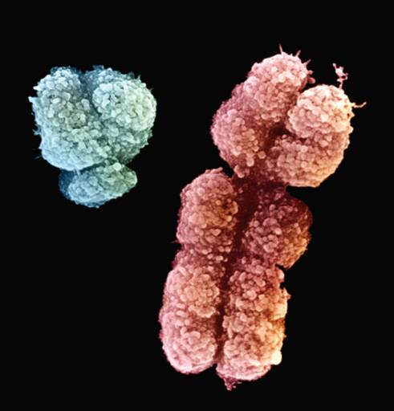
Sex-linked genes
There is a special pattern of inheritance for genes on the sex chromosomes. Mammals have chromosomal sex determination.
Females have two homologous sex chromosomes (XX) and males have two nonhomologous sex chromosomes (XY).
Humans have 23 pairs of chromosomes, 22 pairs of autosomes, and 1 pair of sex chromosomes.
Human X and Y chromosomes (or sex chromosomes) differ physically as well as in the genes they carry.

Slide 25
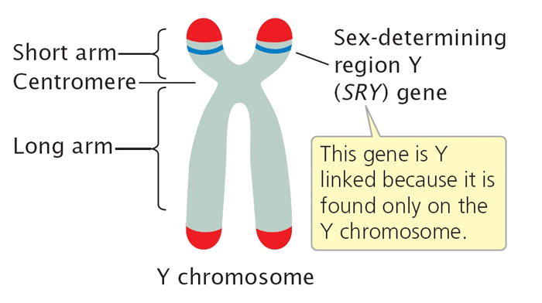

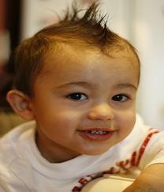
Sex Determination in Humans
Every egg has an X
Half of sperm cells have an X and half have a Y
Y chromosome is small, but has SRY gene
SRY triggers testosterone synthesis
X chromosome carries 1,141 genes
(Some of these genes are associated with sexual traits, but most deal with non-sexual traits)
XX
XY

Slide 26
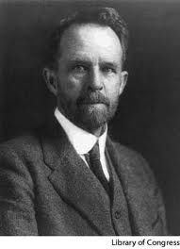
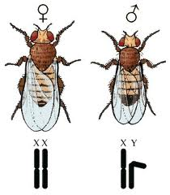
X-Linked Inheritance
Early 1900s, Thomas Morgan studied Drosophila melanogaster
Was able to prove that a specific gene on an X chromosome was not on a Y chromosome
First person to link a specific chromosome to a specific trait and also first to receive Nobel Prize for Genetics

Slide 27
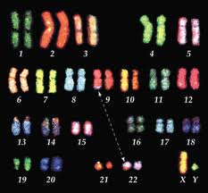
Karyotyping
Images constructed to analyze the structure and number of chromosomes in an individual’s cells
Can find abnormalities in chromosome structure or altered chromosome number
Blood is taken and the cells are forced into mitotic metaphase and arrested there with colchicine.
Colchicine keeps spindle fibers from forming.

Slide 28
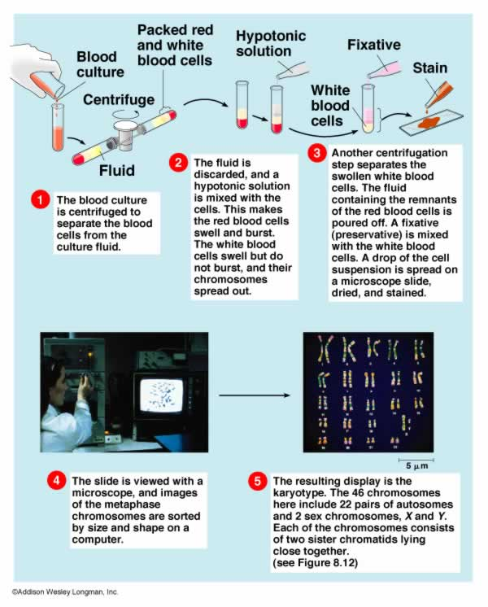

Slide 29
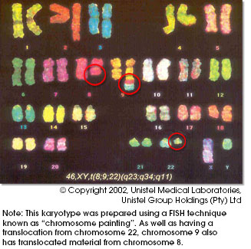
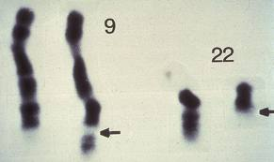
Spectral Karyotyping
Fluorescent dyes help to reveal abnormalities
1st chromosome associated with cancer – The Philadelphia Chromosome (Ph)
Extra length at chromosome 9 is actually a piece of 22
Because of DNA damage of affected blood cells, the result is production of abnormal enzyme, tyrosine kinase, causes leukemia.

Slide 30
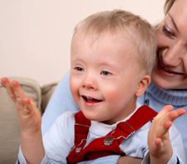
Genetic Disorders

Slide 31
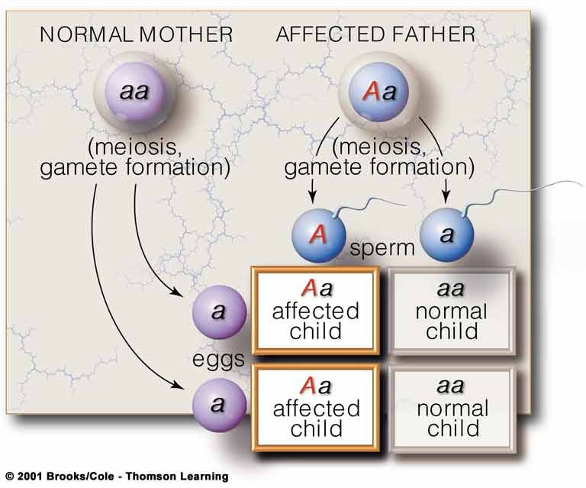
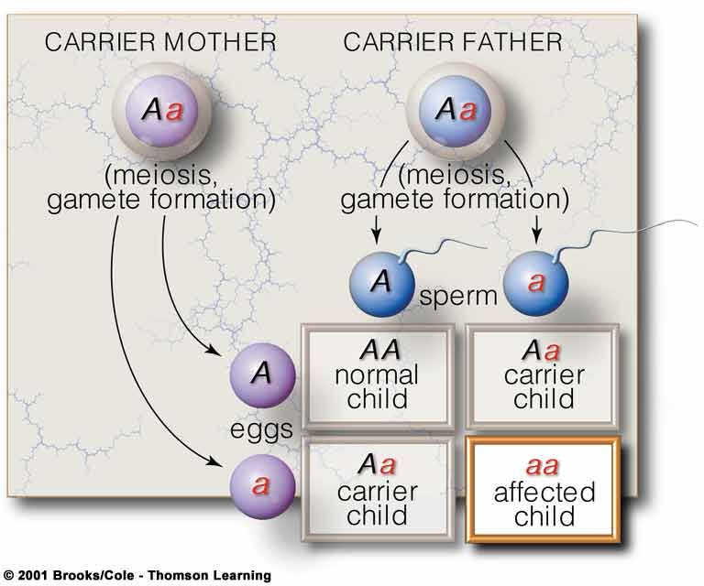
Autosomal Inheritance Patterns:
Autosomal Dominant Inheritance
Autosomal Recessive Inheritance
Achondroplasia
Huntington’s Disease
Hutchinson-Gilford Progeria
Galactosemia
Cystic Fibrosis
Sickle Cell
Tay Sachs
Albinism
Notes:
Autosomal Dominant Inheritance – dominant allele is expressed for homozygous and heterozygous individuals. Tends to appear in every generation affecting both sexes equally.
Autosomal Recessive Inheritance – recessive allele is expressed only in homozygous individuals. Tends to skip a generation and affects both sexes equally.

Slide 32
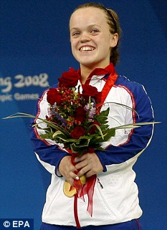



Achondroplasia
Autosomal Dominant Inheritance
Achondroplasia is a form of short-limbed dwarfism. The word achondroplasia literally means "without cartilage formation." Cartilage is a tough but flexible tissue that makes up much of the skeleton during early development. However, in achondroplasia the problem is not in forming cartilage but in converting it to bone (a process called ossification), particularly in the long bones of the arms and legs.
The FGFR3 gene provides instructions for making a protein that is involved in the development and maintenance of bone and brain tissue. Two specific mutations in the FGFR3 gene are responsible for almost all cases of achondroplasia. Researchers believe that these mutations cause the FGFR3 protein to be overly active, which interferes with skeletal development and leads to the disturbances in bone growth seen with this disorder.
Occurs in one in every 15,000 to one in 40,000 live births.

Slide 33
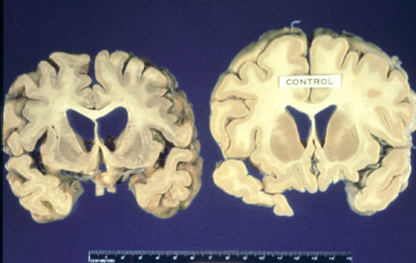
Huntington’s Disease
Autosomal Dominant Inheritance
Huntington disease is a progressive brain disorder that causes uncontrolled movements, emotional problems, and loss of thinking ability (cognition).
Adult-onset Huntington disease, the most common form of this disorder, usually appears in a person's thirties or forties.
Mutations in the HTT gene cause Huntington disease. The HTT gene provides instructions for making a protein called huntingtin. Although the function of this protein is unknown, it appears to play an important role in nerve cells (neurons) in the brain.
The HTT mutation that causes Huntington disease involves a DNA segment known as a CAG trinucleotide repeat. This segment is made up of a series of three DNA building blocks (cytosine, adenine, and guanine) that appear multiple times in a row. Normally, the CAG segment is repeated 10 to 35 times within the gene. In people with Huntington disease, the CAG segment is repeated 36 to more than 120 times.
An increase in the size of the CAG segment leads to the production of an abnormally long version of the huntingtin protein. The elongated protein is cut into smaller, toxic fragments that bind together and accumulate in neurons, disrupting the normal functions of these cells.

Slide 34
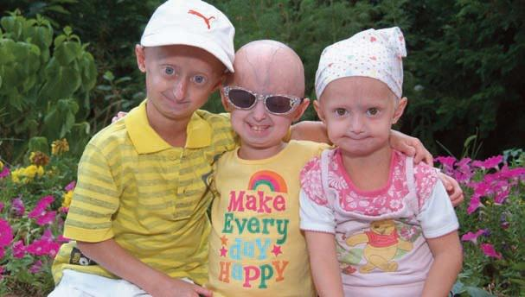
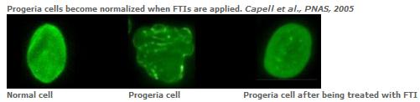
Hutchinson-Gilford Progeria Syndrome
Affected children typically look normal at birth and in early infancy, but then grow more slowly than other children and do not gain weight at the expected rate (failure to thrive). They develop a characteristic facial appearance including prominent eyes, a thin nose with a beaked tip, thin lips, a small chin, and protruding ears. Hutchinson-Gilford progeria syndrome also causes hair loss (alopecia), aged-looking skin, joint abnormalities, and a loss of fat under the skin (subcutaneous fat).
Mutations in the LMNA gene cause Hutchinson-Gilford progeria syndrome.
The LMNA gene provides instructions for making a protein called lamin A. This protein plays an important role in determining the shape of the nucleus within cells. It is an essential scaffolding (supporting) component of the nuclear envelope, which is the membrane that surrounds the nucleus. Mutations that cause Hutchinson-Gilford progeria syndrome result in the production of an abnormal version of the lamin A protein. The altered protein makes the nuclear envelope unstable and progressively damages the nucleus, making cells more likely to die prematurely.
This condition is very rare; it is reported to occur in 1 in 4 million newborns worldwide. More than 130 cases have been reported in the scientific literature since the condition was first described in 1886.
Autosomal Dominant Inheritance

Slide 35
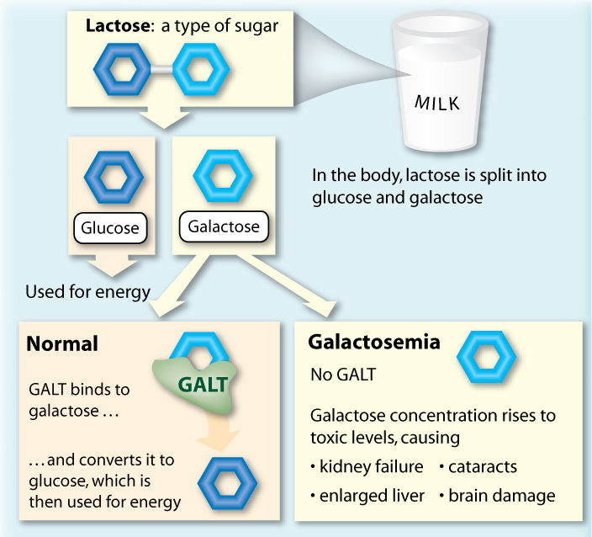
Galactosemia
Autosomal Recessive Inheritance
Galactosemia is a disorder that affects how the body processes a simple sugar called galactose.
Researchers have identified several types of galactosemia. These conditions are each caused by mutations in a particular gene, and affect different enzymes involved in breaking down galactose. Classic galactosemia, also known as type I, is the most common and most severe form of the condition.
Mutations in the GALE, GALK1, and GALT genes cause galactosemia. The GALE, GALK1, and GALT genes provide instructions for making enzymes that are essential for processing galactose obtained from the diet. These enzymes break down galactose into another simple sugar, glucose, and other molecules that the body can store or use for energy.
Mutations in the GALT gene are responsible for classic galactosemia (type I). Most of these genetic changes almost completely eliminate the activity of the enzyme produced from the GALT gene, preventing the normal processing of galactose and resulting in the life-threatening signs and symptoms of this disorder.
Classic galactosemia occurs in 1 in 30,000 to 60,000 newborns.

Slide 36
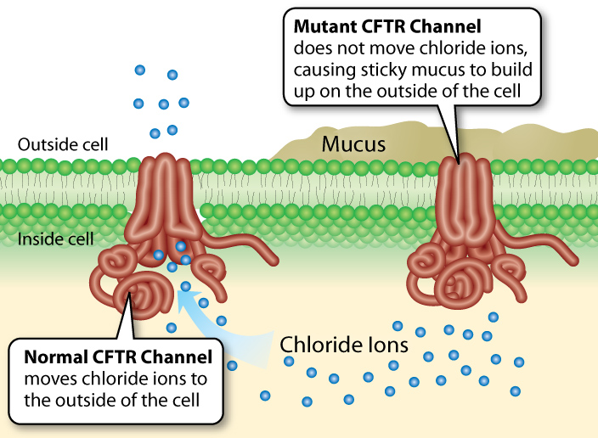
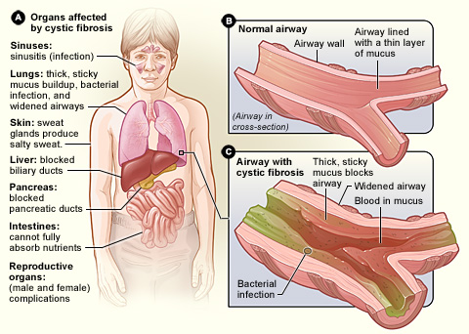
Cystic Fibrosis
Autosomal Recessive Inheritance
Cystic fibrosis is an inherited disease characterized by the buildup of thick, sticky mucus that can damage many of the body's organs. The disorder's most common signs and symptoms include progressive damage to the respiratory system and chronic digestive system problems.
Mutations in the CFTR gene cause cystic fibrosis. The CFTR gene provides instructions for making a channel that transports negatively charged particles called chloride ions into and out of cells. Chloride is a component of sodium chloride, a common salt found in sweat. Chloride also has important functions in cells; for example, the flow of chloride ions helps control the movement of water in tissues, which is necessary for the production of thin, freely flowing mucus.
Mutations in the CFTR gene disrupt the function of the chloride channels, preventing them from regulating the flow of chloride ions and water across cell membranes. As a result, cells that line the passageways of the lungs, pancreas, and other organs produce mucus that is unusually thick and sticky. This mucus clogs the airways and various ducts, causing the characteristic signs and symptoms of cystic fibrosis.

Slide 37
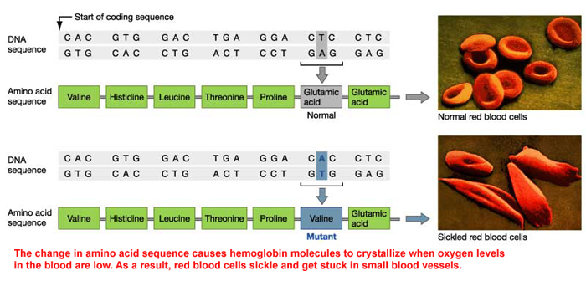
Sickle Cell
Autosomal Recessive Inheritance
There are several types of sickle cell disease. The most common are: Sickle Cell Anemia (SS), Sickle-Hemoglobin C Disease (SC).
Sickle Cell trait (AS) is an inherited condition in which both hemoglobin A and S are produced in the red blood cells, always more A than S. Sickle cell trait is not a type of sickle cell disease. People with sickle cell trait are generally healthy.
Sickle cell conditions are inherited from parents in much the same way as blood type, hair color and texture, eye color and other physical traits. The types of hemoglobin a person makes in the red blood cells depend upon what hemoglobin genes the person inherits from his or her parents. Like most genes, hemoglobin genes are inherited in two sets; one from each parent.

Slide 38
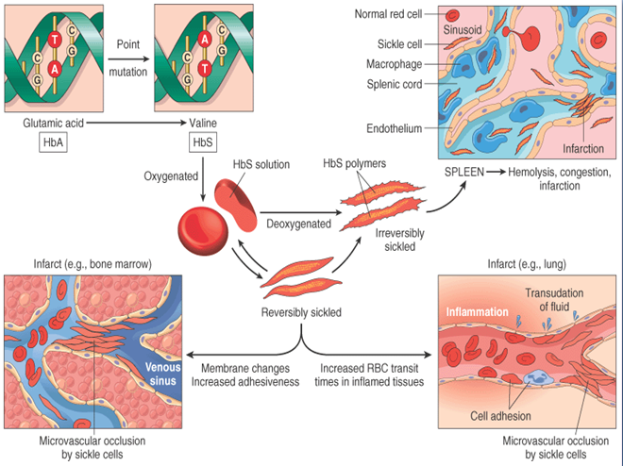
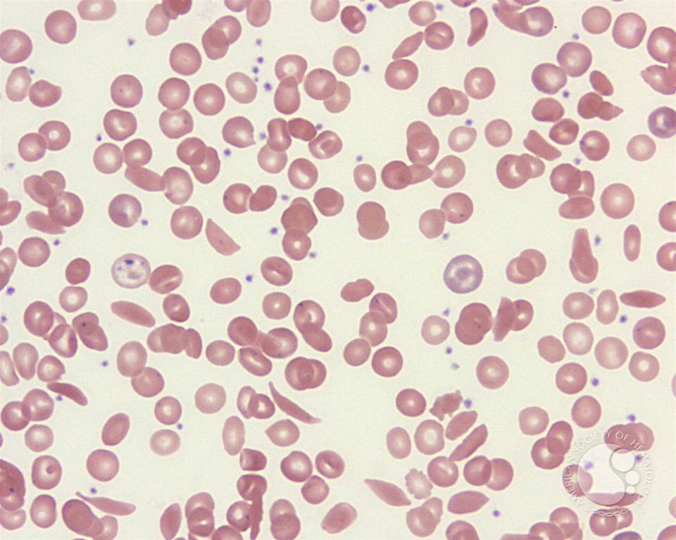
Sickle cell disease is an inherited blood disorder that affects red blood cells. People with sickle cell disease have red blood cells that contain mostly hemoglobin* S, an abnormal type of hemoglobin. Sometimes these red blood cells become sickle-shaped (crescent shaped) and have difficulty passing through small blood vessels.
When sickle-shaped cells block small blood vessels, less blood can each that part of the body. Tissue that does not receive a normal blood flow eventually becomes damaged. This is what causes the complications of sickle cell disease. There is currently no universal cure for sickle cell disease.

Slide 39
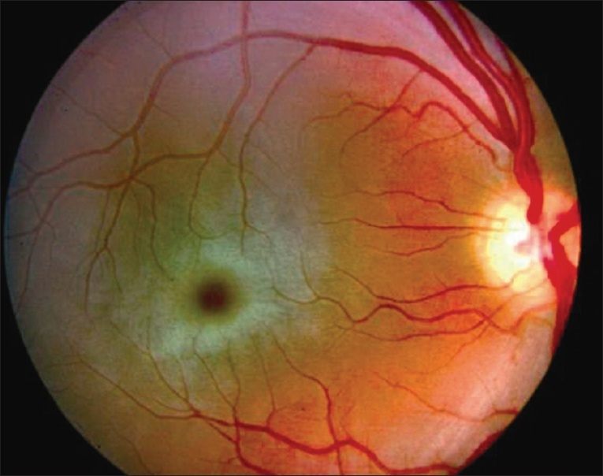
Tay-Sachs Disease
Autosomal Recessive Inheritance
Tay-Sachs disease is a rare inherited disorder that progressively destroys nerve cells (neurons) in the brain and spinal cord.
Mutations in the HEXA gene cause Tay-Sachs disease. The HEXA gene provides instructions for making part of an enzyme called beta-hexosaminidase A, which plays a critical role in the brain and spinal cord. This enzyme is located in lysosomes, which are structures in cells that break down toxic substances and act as recycling centers. Within lysosomes, beta-hexosaminidase A helps break down a fatty substance called GM2 ganglioside.
Mutations in the HEXA gene disrupt the activity of beta-hexosaminidase A, which prevents the enzyme from breaking down GM2 ganglioside. As a result, this substance accumulates to toxic levels, particularly in neurons in the brain and spinal cord. Progressive damage caused by the buildup of GM2 ganglioside leads to the destruction of these neurons, which causes the signs and symptoms of Tay-Sachs disease.
The genetic mutations that cause this disease
are more common in people of Ashkenazi
(eastern and central European) Jewish heritage
than in those with other backgrounds.
Notes:
The most common form of Tay-Sachs disease becomes apparent in infancy. Infants with this disorder typically appear normal until the age of 3 to 6 months, when their development slows and muscles used for movement weaken. Affected infants lose motor skills such as turning over, sitting, and crawling. They also develop an exaggerated startle reaction to loud noises. As the disease progresses, children with Tay-Sachs disease experience seizures, vision and hearing loss, intellectual disability, and paralysis. An eye abnormality called a cherry-red spot, which can be identified with an eye examination, is characteristic of this disorder.

Slide 40
Neurobiological Disorders:
Depression
Schizophrenia
Bipolar disorder
? Mutant alleles in specific regions of certain autosomes may
increase the chances of developing these disorders ?

Slide 41
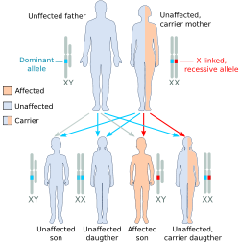
X-Linked Patterns:
If disease comes only from a recessive allele and is carried on an X-chromosome, who is most likely to be affected, daughter or son?

Slide 42
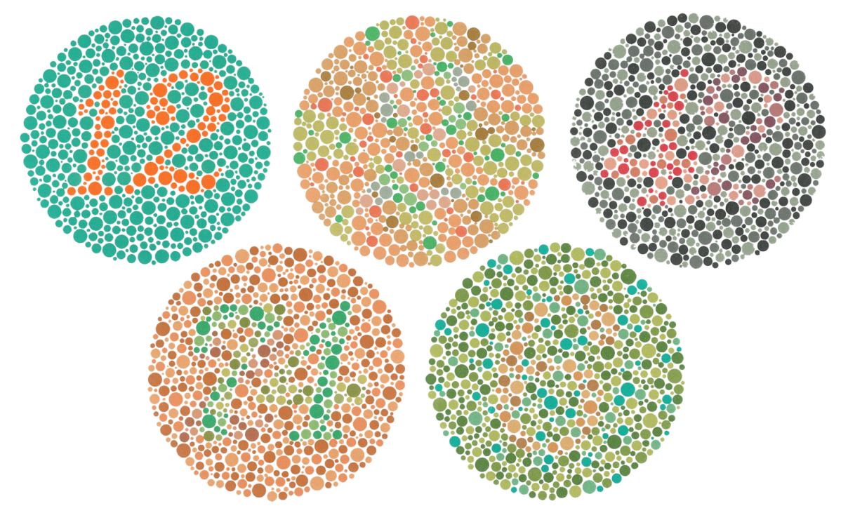
Red-Green Color Blindness
Sex-Linked Disorder
In humans the gene that allows individuals to distinguish between the colors of red and green is carried on the X chromosome.
There are two alleles: X^{C} - the non-colorblind allele
X^{c} - the colorblind allele
The colorblind allele is recessive.
Mutant gene products alter photoreceptors in eyes
Normally we see 150 colors, but people with this can see fewer than 25. http://www.toledo-bend.com/colorblind/ishihara.asp
More common in men, but does show up in heterozygous women.

Slide 43
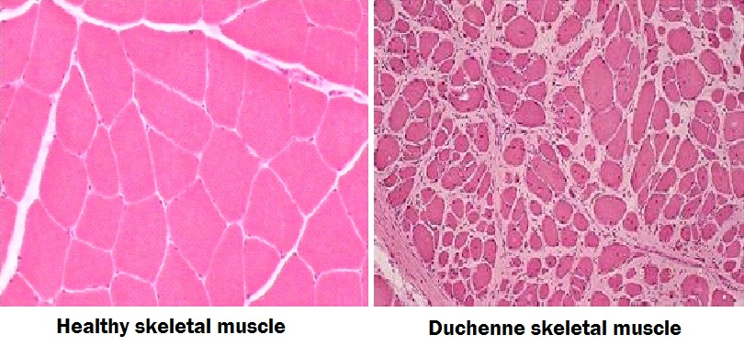
Duchenne Muscular Dystrophy (DMD)
Duchenne muscular dystrophy (DMD) is a genetic disorder characterized by progressive muscle degeneration and weakness. It is one of nine types of muscular dystrophy.
DMD is caused by an absence of dystrophin, a protein that helps keep muscle cells intact. Symptom onset is in early childhood, usually between ages 3 and 5. The disease primarily affects boys, but in rare cases it can affect girls.
Duchenne muscular dystrophy occurs in about 1 out of every 3,600 male infants.
Sex-Linked Disorder

Slide 44
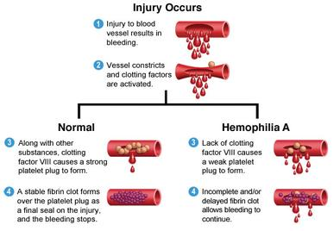
Hemophilia
Sex-Linked Disorder
Hemophilia is a rare bleeding disorder in which the blood doesn't clot normally. If you have hemophilia, you may bleed for a longer time than others after an injury.
People born with hemophilia have little or no clotting factor. Clotting factor is a protein needed for normal blood clotting. There are several types of clotting factors. These proteins work with platelets to help the blood clot.
The two main types of hemophilia are A and B. If you have hemophilia A, you're missing or have low levels of clotting factor VIII (8). About 8 out of 10 people who have hemophilia have type A. If you have hemophilia B, you're missing or have low levels of clotting factor IX (9).

Slide 45
Heritable Changes in Chromosome Structure
Chromosome mutations – changes in the structure of a chromosome or loss of an entire chromosome.
Deletion – loss of piece of DNA due to chromosomal breakage.
Duplication – chromosomes steal part of homologs and have both alleles for each gene involved due to unequal crossovers at prophase I because homologous chromosomes misalign.
Inversion – piece of DNA breaks off and reattaches itself in the opposite direction.
Translocation – chromosome breaks off and reattaches to a non-homologous chromosome.
Nondisjunction – chromosome does not properly separate from its homolog during meiosis.

Slide 46
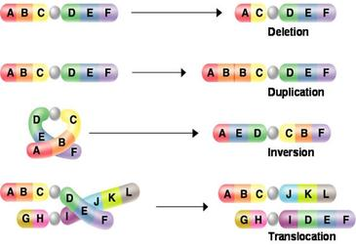

Slide 47
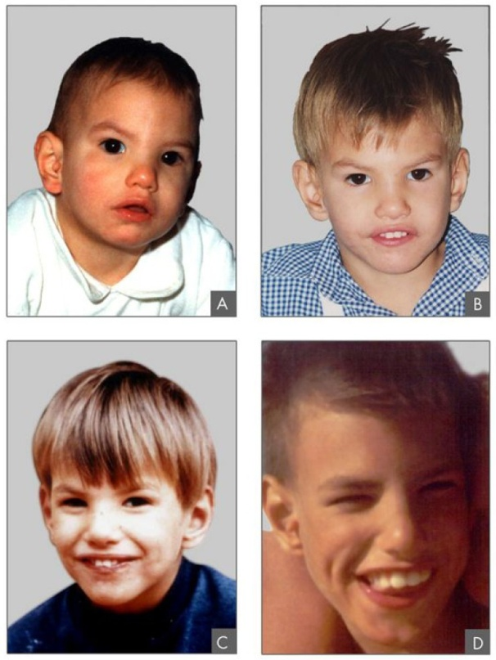
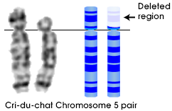

Cri-du-chat
Disorder due to Change in Chromosome Structure
Cri-du-chat (cat's cry) syndrome, also known as 5p- (5p minus) syndrome, is a chromosomal condition that results when a piece of chromosome 5 is missing. Infants with this condition often have a high-pitched cry that sounds like that of a cat. The disorder is characterized by intellectual disability and delayed development, small head size (microcephaly), low birth weight, and weak muscle tone (hypotonia) in infancy.
Cri-du-chat syndrome is caused by a deletion of the end of the short (p) arm of chromosome 5.
Cri-du-chat syndrome occurs in an estimated 1 in 20,000 to 50,000 newborns.

Slide 48
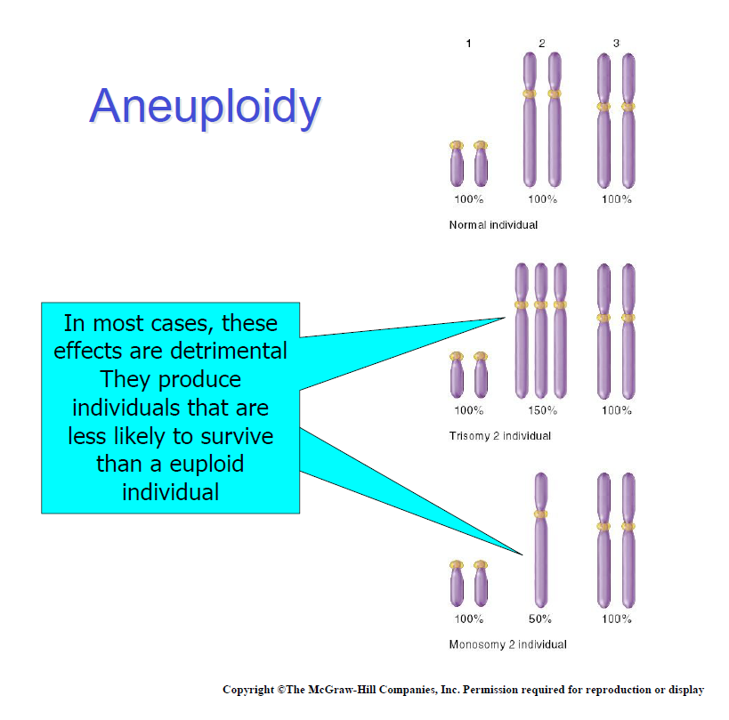
Variation in Chromosome Number
Chromosome numbers can vary in two main ways:
Euploidy
Variation in the number of complete sets of chromosome.
Variations occur occasionally in animals and frequently in plants.
Aneuploidy
Variation in the number of particular chromosomes within a set.
Variations are always regarded as abnormal conditions.
Alterations in chromosome number occur
frequently during gamete formation.
- About 5-10% of embryos have abnormal
chromosome number.
- About 50% of spontaneous abortions are
due to such abnormalities.

Slide 49
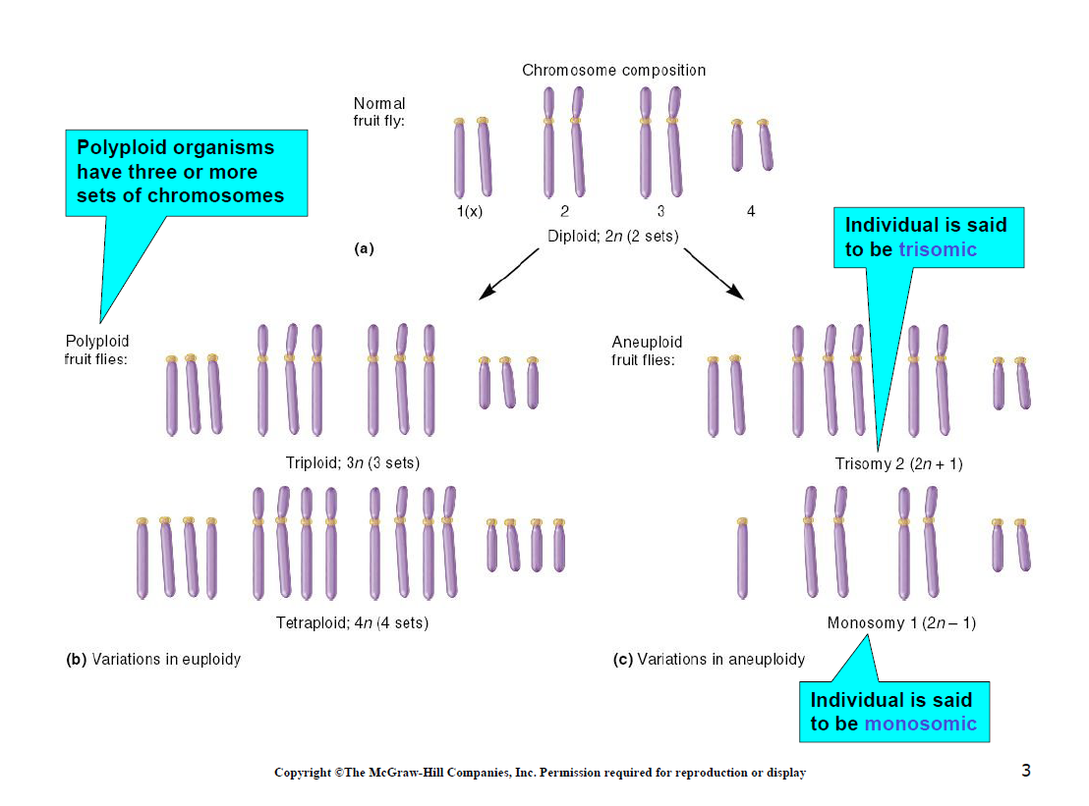

Slide 50
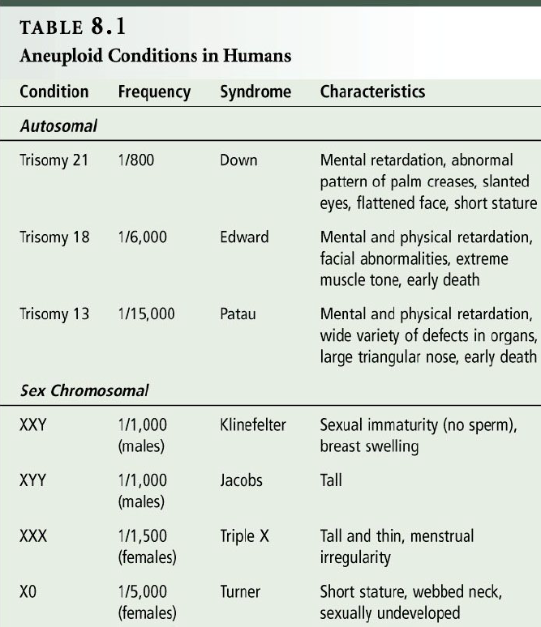

Slide 51

Down Syndrome
Disorder due to Change in Chromosome #
Down syndrome is a chromosomal condition that is associated with intellectual disability, a characteristic facial appearance, and weak muscle tone (hypotonia) in infancy. All affected individuals experience cognitive delays, but the intellectual disability is usually mild to moderate.
Most cases of Down syndrome result from trisomy 21, which means each cell in the body has three copies of chromosome 21 instead of the usual two copies.
Less commonly, Down syndrome occurs when part of chromosome 21 becomes attached (translocated) to another chromosome during the formation of reproductive cells (eggs and sperm) in a parent or very early in fetal development. Affected people have two normal copies of chromosome 21 plus extra material from chromosome 21 attached to another chromosome, resulting in three copies of genetic material from chromosome 21. Affected individuals with this genetic change are said to have translocation Down syndrome.
Down syndrome occurs in about 1 in 830 newborns.
An estimated 250,000 people in the United States
have this condition. Although women of any age can
have a child with Down syndrome, the chance of
having a child with this condition increases as a
woman gets older.

Slide 52

Patau Syndrome
Disorder due to Change in Chromosome #
Trisomy 13, also called Patau syndrome, is a chromosomal condition associated with severe intellectual disability and physical abnormalities in many parts of the body. Individuals with trisomy 13 often have heart defects, brain or spinal cord abnormalities, very small or poorly developed eyes (microphthalmia), extra fingers or toes, an opening in the lip (a cleft lip) with or without an opening in the roof of the mouth (a cleft palate), and weak muscle tone (hypotonia).
Most cases of trisomy 13 result from having three copies of chromosome 13 in each cell in the body instead of the usual two copies. The extra genetic material disrupts the normal course of development, causing the characteristic features of trisomy 13.
Trisomy 13 can also occur when part of chromosome 13 becomes attached (translocated) to another chromosome during the formation of reproductive cells (eggs and sperm) or very early in fetal development.
Trisomy 13 occurs in about 1 in 16,000 newborns.
Although women of any age can have a child with
trisomy 13, the chance of having a child with this
condition increases as a woman gets older.

Slide 53


Turner Syndrome
Disorder due to Change in Chromosome #
Turner syndrome is a chromosomal condition that affects development in females. The most common feature of Turner syndrome is short stature, which becomes evident by about age 5. An early loss of ovarian function (ovarian hypofunction or premature ovarian failure) is also very common. The ovaries develop normally at first, but egg cells (oocytes) usually die prematurely and most ovarian tissue degenerates before birth.
Turner syndrome results when one normal X chromosome is present in a female's cells and the other sex chromosome is missing or structurally altered. The missing genetic material affects development before and after birth. About half of individuals with Turner syndrome have monosomy X, which means each cell in the individual's body has only one copy of the X chromosome instead of the usual two sex chromosomes.
This condition occurs in about 1 in 2,500 newborn girls worldwide,
but it is much more common among pregnancies that do not survive
to term (miscarriages and stillbirths).

Slide 54

Klinefelter’s Syndrome
Disorder due to Change in Chromosome #
Klinefelter syndrome is a chromosomal condition that affects male physical and cognitive development. Its signs and symptoms vary among affected individuals.
Affected individuals typically have small testes that do not produce as much testosterone as usual. A shortage of testosterone can lead to delayed or incomplete puberty, breast enlargement (gynecomastia), reduced facial and body hair, and an inability to have biological children (infertility).
Most often, Klinefelter syndrome results from the presence of one extra copy of the X chromosome in each cell (47,XXY). Extra copies of genes on the X chromosome interfere with male sexual development, often preventing the testes from functioning normally and reducing the levels of testosterone.
Klinefelter syndrome affects 1 in 500 to 1,000 newborn males.

Slide 55


Does Chromosome Structure Evolve?
Alterations in chromosome structure might have contributed to the differences among closely related organisms.
* 18 pairs of chromosomes almost identical to chimpanzees and gorillas; the other 5 differ only at inversion and translocated regions.
During human evolution, two chromosomes in early ancestors fused, end-to-end, to form chromosome 2.
* In fused regions, researchers have discovered remnants of a telomere.
Figure 12.15 page 197

Slide 56

Pedigrees
Charts of genetic connections among individuals.
Hemophilia: “The Royal Disease”

Slide 57


99 Balloons
https://www.youtube.com/watch?v=th6Njr-qkq0
Notes:
Trisomy 18, also called Edwards syndrome, is a chromosomal condition associated with abnormalities in many parts of the body. Individuals with trisomy 18 often have slow growth before birth (intrauterine growth retardation) and a low birth weight. Affected individuals may have heart defects and abnormalities of other organs that develop before birth. Other features of trisomy 18 include a small, abnormally shaped head; a small jaw and mouth; and clenched fists with overlapping fingers.
Most cases of trisomy 18 result from having three copies of chromosome 18 in each cell in the body instead of the usual two copies. The extra genetic material disrupts the normal course of development, causing the characteristic features of trisomy 18.
Trisomy 18 occurs in about 1 in 5,000 live-born infants; it is more common in pregnancy, but many affected fetuses do not survive to term. Although women of all ages can have a child with trisomy 18, the chance of having a child with this condition increases as a woman gets older.

